Slide 1







Enterprise Blockchain Developers (Intermediate)
In support of
Powered By

Slide 2
Outline
Dive into Proxy (Architect a Solidity Program)
Code Demo
Key Concepts
Lifecycle Methods
Functional Component and Hooks
Code Demo
© 2017-2020 SmartMesh Foundation Pte. Ltd. | MeshBox Foundation Pte. Ltd.

Slide 3
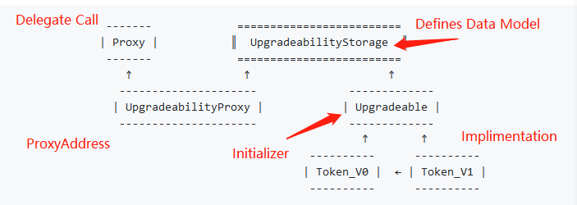
Dive into Proxy (Architect a Solidity Program)
Inherited, Unstructured, External Storage, ProxyFactory and ProxyAdmin
(Code Explain)
Inherited
What does it mean by upgradability? there is a initializer in the smartcontract or there are no constructor / initializer

Slide 4
Dive into Proxy (Architect a Solidity Program)
Drawbacks:
Data Model cannot be changed, can only be updated or add new features
(Code Explain)

Slide 5
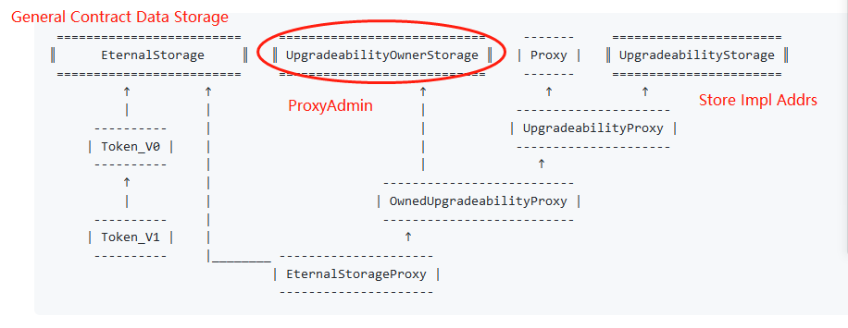
Dive into Proxy (Architect a Solidity Program)
Eternal Storage
(Code Explain)

Slide 6
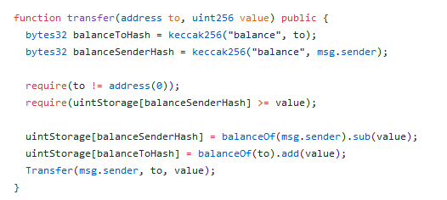
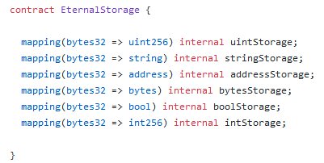
Dive into Proxy (Architect a Solidity Program)
Eternal Storage

Slide 7
Dive into Proxy (Architect a Solidity Program)
Pros:
The actural impl contract's data structure doesn't need to follow the previous impl contract's data structure
Cons:
Hard to write, as we need to extract all the data storing out

Slide 8
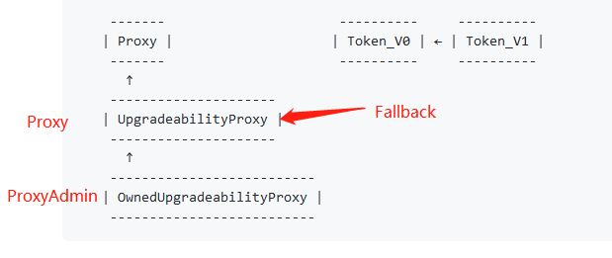
Dive into Proxy (Architect a Solidity Program)
Unstructured
(Code Explain)

Slide 9
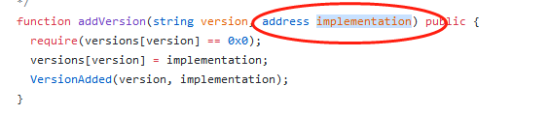

Dive into Proxy (Architect a Solidity Program)
Unstructured
Use pregenerated impl address
Use fixed impl Use pregenerated address
address

Slide 10
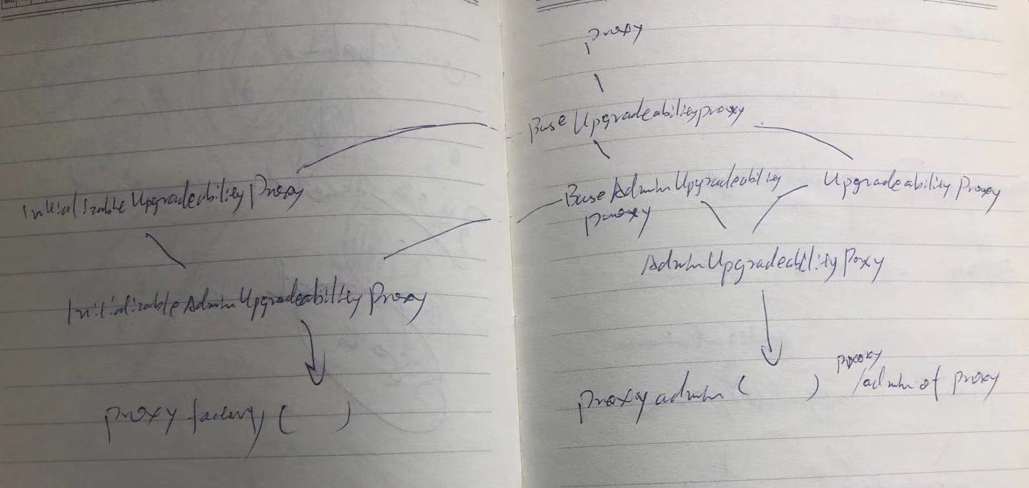
Dive into Proxy (Architect a Solidity Program)
ProxyAdmin & ProxyFactory (Code Explain)
Check if IniupgradProxy and AdminUpgradeProx have initializer (Inherited with admin)
Unstructured Storage has contrustor, so can use upgradeto without init data

Slide 11
Code Demo
Upgrade StoreFactory from depolymini to depoly and add Proxy admin

Slide 12
Web3js
1 change class to functional component
2 add context

